Slide 1
Exploring Crowd Consistency in a Mechanical Turk Survey
Peng Sun & Kathryn T. Stolee
{psun2, ktstolee}@ncsu.edu
Computer Science Department
North Carolina State University

Slide 2
Motivation
Crowdsourcing is a common approach for conducting empirical studies in software engineering.
Program synthesis (R. A. Cochran et al. 2015)
Program verification (T. W. Schiller et al. 2012)
Testing (E. Dolstra et al. 2013)

Slide 3
Motivation
Issues:
Distracted participants.
Intentionally random click through.
Unknown/uncontrolled population.

Slide 4
Motivation
It is important to measure and control response quality.

Slide 5
Research Questions
RQ1: What percentage of MTurk participants have a computer science or IT background?
RQ2: What are the participants’ motivations for using crowdsourcing platform Amazon’s Mechanical Turk?
RQ3: How consistent are the characteristics of samples of participants on MTurk?
RQ4: How consistent are MTurk participants when ask questions about themselves and their experiences?

Slide 6
Research Questions
RQ1: What percentage of MTurk participants have a computer science or IT background?
RQ2: What are the participants’ motivations for using crowdsourcing platform Amazon’s Mechanical Turk?
RQ3: How consistent are the characteristics of samples of participants on MTurk?
RQ4: How consistent are MTurk participants when ask questions about themselves and their experiences?

Slide 7
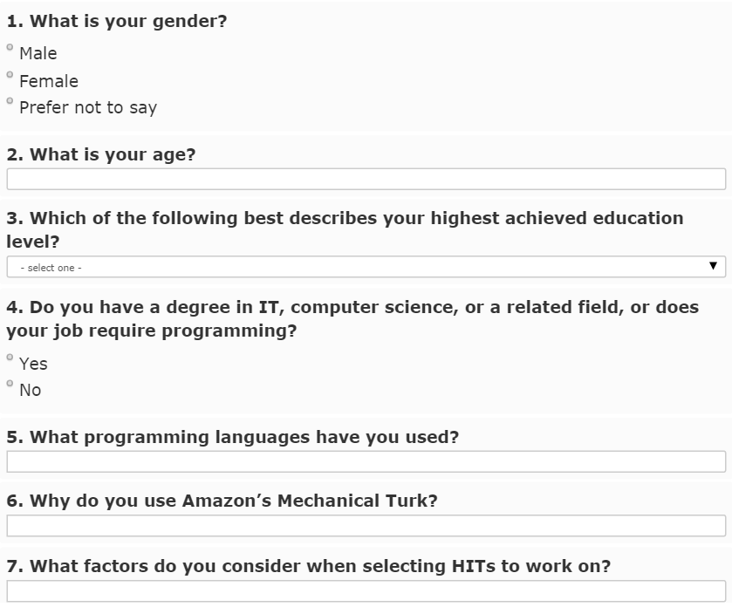

Slide 8
Study Design
Study 1
N = 300
Study 2
N = 300

Slide 9
RQ3: Consistency of sample characteristics
Proportion test of independent sample
from Study 1 and Study 2
Characteristics | Study 1 | Study 2 | p-value
Gender
-Male | 48% | 37% | 0.004934**
-Female | 51% | 63% | 0.004934**
Hold CS Degree
-CS | 36% | 22% | <0.001***
-No-CS | 61% | 77% | <0.001***

Slide 10
RQ3: Consistency of sample characteristics
Multiple study samples provide a more representative sample population.
With large samples of 300 participants, finding significant differences was unexpected.

Slide 11
RQ4: Within-participant consistency
Notes:
Be sure to mention *why* this is consistent.

Slide 12
RQ4: Within-participant consistency
Study 1
N = 300
Study 2
N = 300

Slide 13
RQ4: Within-participant consistency
Study 3
N = 600
Study 1
N = 300
Study 2
N = 300

Slide 14
RQ4: Within-participant consistency
Study 3
N = 600
Study 1
N = 300
Study 2
N = 300
86
50

Slide 15
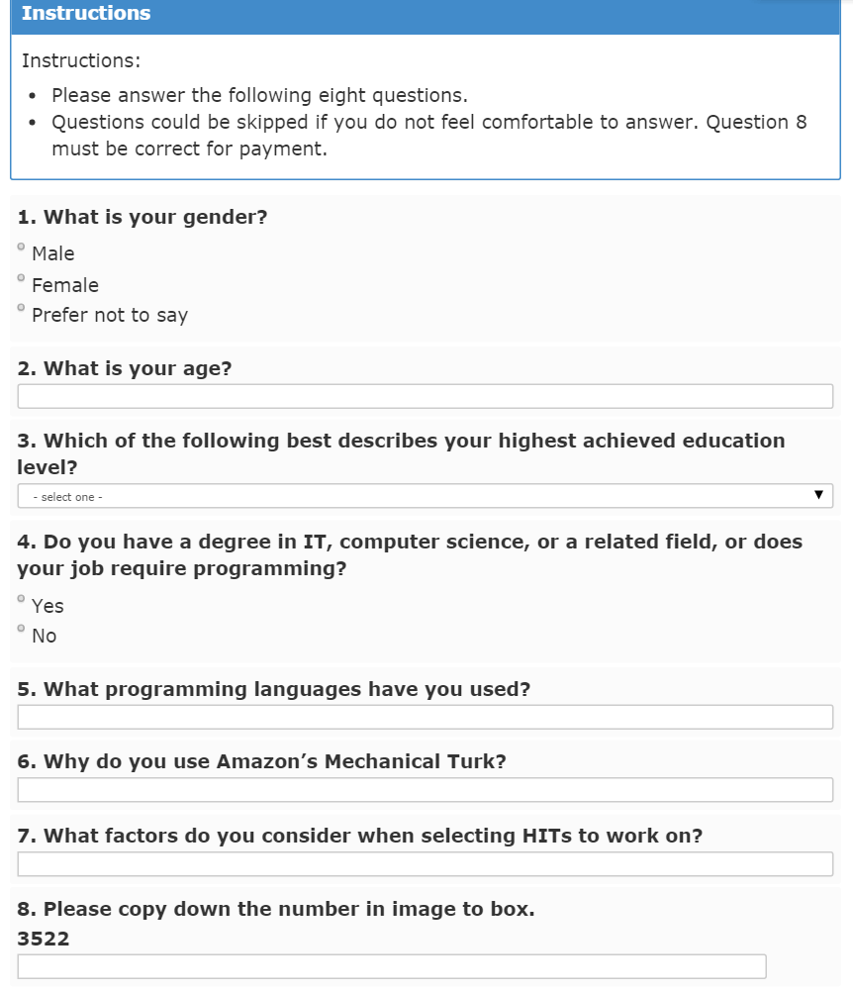
Consistent?
Notes:
As a reminder, show the survey again and identify the questions (visually) used for the consistency analysis

Slide 16
RQ4: Within-participant consistency
Consistency metric - example
Study 1 | Study 3 | Label
Female | Female | consistent

Slide 17
RQ4: Within-participant consistency
Consistency metric - example
Study 1 | Study 3 | Label
Female | Female | consistent
Male |  | consistent
Notes:
Be sure to mention *why* this is consistent.

Slide 18
RQ4: Within-participant consistency
Consistency metric - example
Study 1 | Study 3 | Label
Female | Female | consistent
Male |  | consistent
Male | Female | inconsistent

Slide 19
RQ4: Within-participant consistency
Consistency metric - example
Study 1 | Study 3 | Label
Female | Female | consistent
Male |  | consistent
Male | Female | inconsistent
Male | Prefer not to say | inconsistent

Slide 20
RQ4: Within-participant consistency
Number of questions answered inconsistently
Questions | Participants | Percentage
0 | 95 | 70%
1 | 36 | 26%
2 | 3 | 2%
3 | 2 | 1%

Slide 21
RQ4: Within-participant consistency
Number of questions answered inconsistently
Questions | Participants | Percentage
0 | 95 | 70%
1 | 36 | 26%
2 | 3 | 2%
3 | 2 | 1%

Slide 22
RQ4: Within-participants consistency
Answer Consistency for Repeat Participants
 | Gender (Q1) | Age (Q2) | Edu Level (Q3) | CS Degree (Q4) | Individuals
Consistent | 96% (131) | 91% (124) | 88% (120) | 89% (121) | 70% (95)
Inconsistent | 4% (5) | 9% (12) | 12% (16) | 11% (15) | 30% (41)

Slide 23
RQ4: Within-participants consistency
Answer Consistency for Repeat Participants
 | Gender (Q1) | Age (Q2) | Edu Level (Q3) | CS Degree (Q4) | Individuals
Consistent | 96% (131) | 91% (124) | 88% (120) | 89% (121) | 70% (95)
Inconsistent | 4% (5) | 9% (12) | 12% (16) | 11% (15) | 30% (41)

Slide 24
RQ4: Within-participants consistency
Answer Consistency for Repeat Participants
Of the participants who answered two surveys, 30% answer inconsistently on at least one questions.
 | Gender (Q1) | Age (Q2) | Edu Level (Q3) | CS Degree (Q4) | Individuals
Consistent | 96% (131) | 91% (124) | 88% (120) | 89% (121) | 70% (95)
Inconsistent | 4% (5) | 9% (12) | 12% (16) | 11% (15) | 30% (41)

Slide 25
RQ4: Within-participants consistency
Answer Consistency for Repeat Participants
Of the participants who answered two surveys, 30% answer inconsistently on at least one questions.
This is consistent with prior work that has found 39% of participants do not answer HITs conscientiously (J. S. Downs et al. 2010).
 | Gender (Q1) | Age (Q2) | Edu Level (Q3) | CS Degree (Q4) | Individuals
Consistent | 96% (131) | 91% (124) | 88% (120) | 89% (121) | 70% (95)
Inconsistent | 4% (5) | 9% (12) | 12% (16) | 11% (15) | 30% (41)

Slide 26
RQ4: Within-participant consistency
Consistency of workers with CS/IT background
 | Inconsistent | Percentage
CS | 11/45 | 24%
Non-CS | 9/69 | 13%

Slide 27
RQ4: Within-participant consistency
Consistency of workers with CS/IT background
Participants in the CS group tend to be less consistent than those who do not.
 | Inconsistent | Percentage
CS | 11/45 | 24%
Non-CS | 9/69 | 13%

Slide 28
Recap
We wanted to measure response quality:
Significant differences in population characteristics were found (n=300)
30% of participants (n=136) answered inconsistently
CS workers are more likely to be inconsistent

Slide 29
Were these results a fluke?
Notes:
At this point, you’ve told the audience a lot about how MTurk is bad, from this one experiment.
Now, we’re curious. When we replicate the survey, are there similar types of inconsistencies?

Slide 30
NEW: Replication - not in the paper!
Study 4
N = 300
Study 5
N = 300

Slide 31
NEW: Replication - not in the paper!
Study 4
N = 300
Study 5
N = 300
27

Slide 32
Motivation
It is important to measure and control response quality.

Slide 33
Replication
Respondents are more likely to pay effort to answer a survey if they perceive they are valuable for research (J. A. Krosnick et al. 1991).

Slide 34
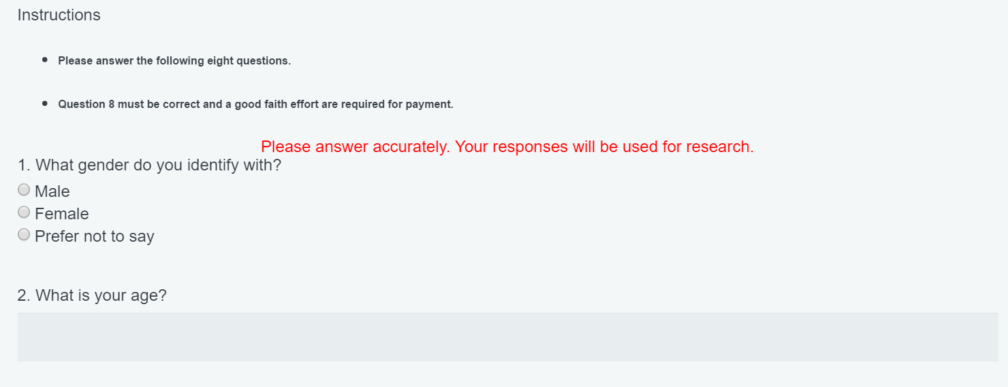


Slide 35
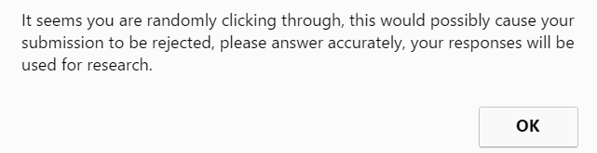
Replication

Slide 36
Comparison
Results in Paper
Replication
30% (41/136) inconsistent.
30% (8/27) inconsistent.

Slide 37
Comparison
Results in Paper
Replication
30% (41/136) inconsistent.
Gender, CS background are significantly different across samples.
30% (8/27) inconsistent.
No significant difference found in characteristics across samples.

Slide 38
Comparison
Results in Paper
Replication
30% (41/136) inconsistent.
Gender, CS background are significantly different across samples.
30% (8/27) inconsistent.
No significant difference found in characteristics across samples.
Students are significantly less likely to be warned.

Slide 39
Implications
The inconsistency rate in the paper is
probably not a fluke.

Slide 40
Improving workers’ conscientious response
Despite prior research, we showed that strategies below did not work well:
Making participants perceive they are valuable for research.
Warning participants when empty answers or spending short time happens.
So….. what can be done?

Slide 41
Next Steps
Try again with larger overlapped samples.
Try again with more meaningful tasks than a survey.
Find other ways to make respondent respond mindfully.
Can money buy consistency?
4. Train underskilled crowd to perform tasks require expertise.
Instructional tutors.
Gold standard.

Slide 42
Exploring Crowd Consistency in a Mechanical Turk Survey
Peng Sun, psun2@ncsu.edu
Katie Stolee, ktstolee@ncsu.edu

Slide 43
RQ1: Percentage of Computer Science experience workforce
Approximately 24% of MTurk worker are potentially qualified.
The most known programming language is Java. Metrics: bag of words.
The pool of participants is also particularly well educated with 70% having a college degree.

Slide 44
RQ2: Workers’ Motivation
Most participants (86%) use MTurk for payment.
Metrics:
keywords: “money”, “cash”, “income”, “pay”, “part time”, “payment”, and “earn” from bag of words analysis for Question 6.

Slide 45
Threats to Validity
Internal validity:
Samples are biased toward people who want money, impacting the results of motivations.

Slide 46
Threats to Validity
External validity:
Larger sample.
Other crowdsourcing platforms.

